Slide 1



Uber Privacy-by-Design Assessment Presentation
June 25, 2024
Dr. Mueen Uddin
Privacy in the Digital Era (DACS 3301-1)
Group Members:
Almabrouk Ben-Omran (60104920)
Ali Ranjbar (60101696)
Mohammad Ashjar (60106321)

Slide 2
This presentation will discuss:
Initial Information Request (Application Overview)
Privacy-by-Design Controls Assessment
Recommendations

Slide 3
Initial Information Request
(Application Overview)

Slide 4



Uber Application Assessment
Organization: Uber Technologies, Inc.
Assessors: Ali Ranjbar, Almabrouk Ben-Omran, Mohammad Ashjar (students)
Assessment Start Date: 16/05/2024
Application Type: Transportation service
Original Developers: Travis Kalanick, Garret Camp

Slide 5
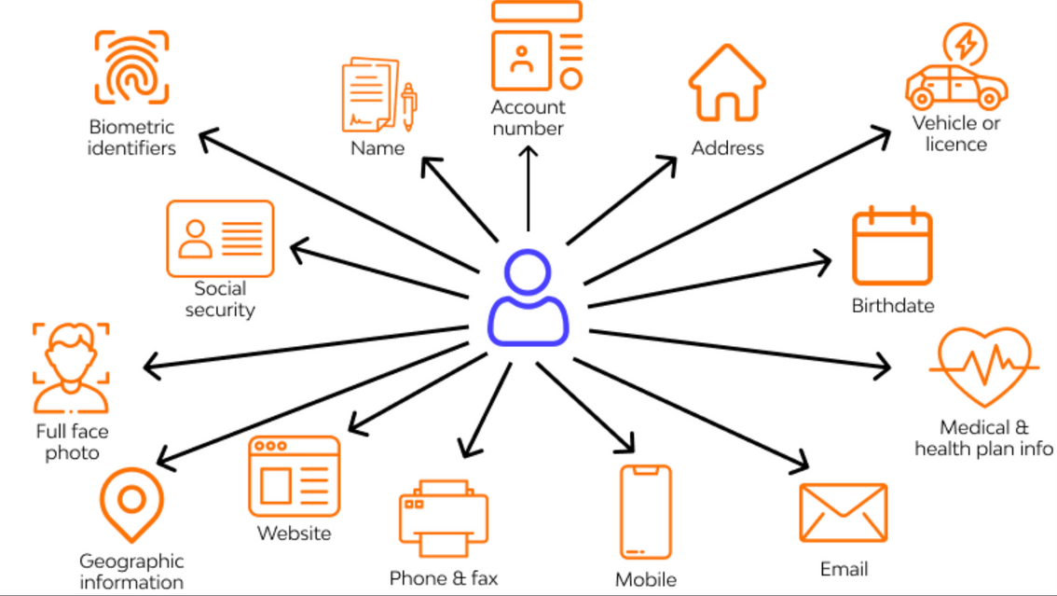
Data Processing:
Personal Data: Name, Phone, Email, Location, Payment info (optional), Profile photo, Travel history, Device info, Audio recordings (optional), Emergency Contacts (optional)
Users: Individuals (data subjects)
Access: Uber Employees, Drivers, Third-party Service Providers, Government Authorities, Marketing/Analytics Partners, Auditors, Users

Slide 6
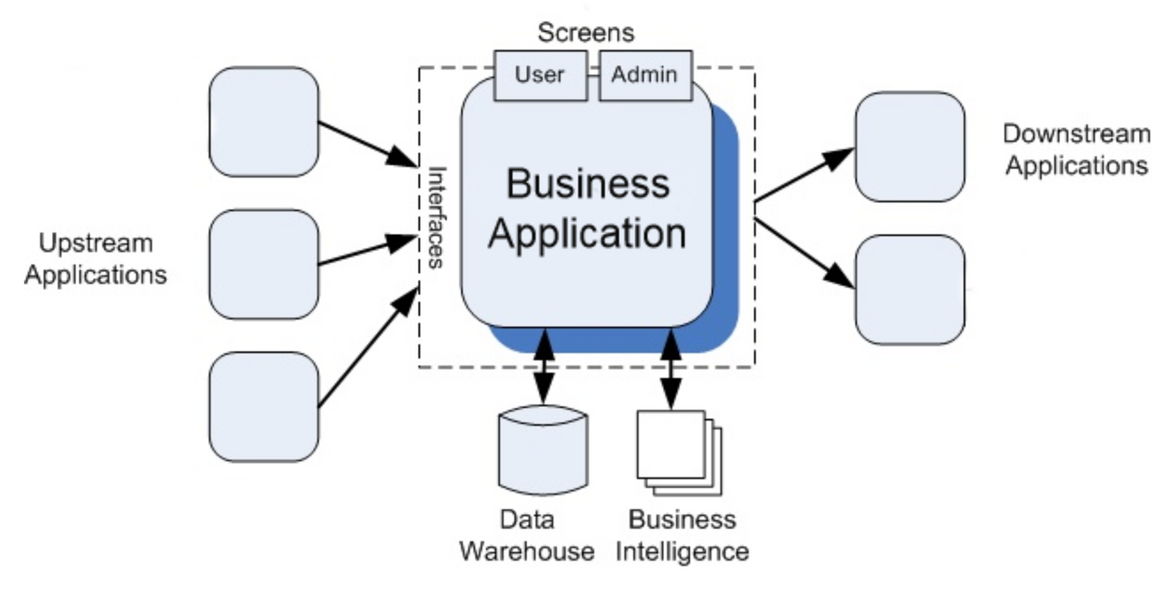
Integration:
Upstream Apps: Google Maps API, Apple Pay, GCP, Firebase, Mapbox, Stripe, PayPal, Google Pay, Onfido, Jumio, AWS, OAuth, Firebase Authentication, Twilio
Downstream Apps: Uber Rider/Driver Apps, Internal Analytics Tools, Google Analytics, Mixpanel, Amplitude, Zendesk, Salesforce, Braze, HubSpot, Uber Eats/Freight, Jump Bikes, Regulatory Reporting Tools, Audit Tools, Concur, TripActions

Slide 7
Data Processing Activities:
Account Management, Location Tracking, Ride History, Payment Processing, Communication, Identity Verification, Feedback, Customer Support, Marketing, Analytics, Compliance, Accessibility
Data Sharing:
External Parties: Payment Processors, Mapping Services, Third-party Providers, Government Authorities, Marketing Partners, Business Partners

Slide 8
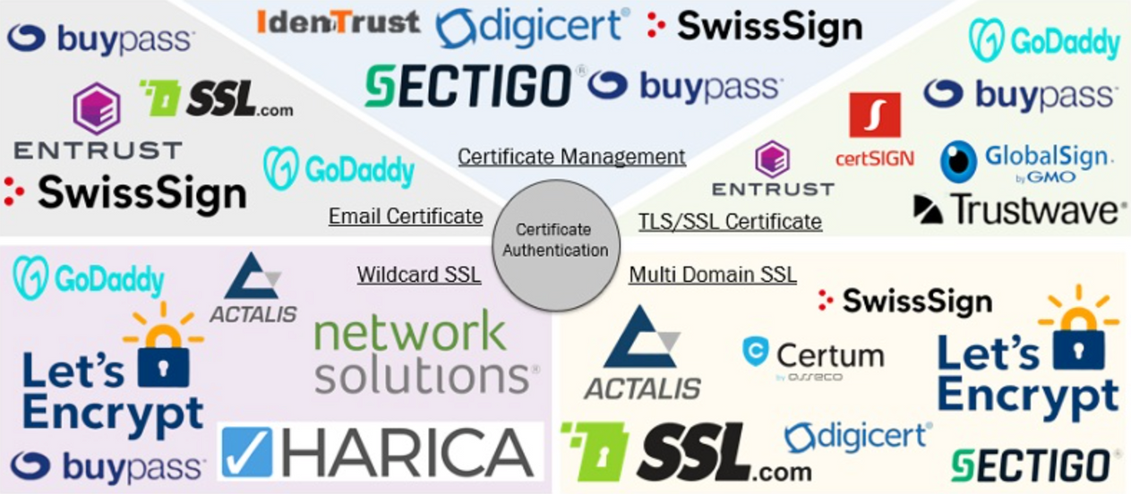
Hosting & Architecture:
Hosting: Google Cloud Platform (GCP), Oracle Cloud Infrastructure (OCI)
Updates: Continuous Integration/Deployment (CI/CD)
Architecture: Transitioned from Monolithic to Domain-Oriented Microservices (DOMA)
Security:
SSL Certificates: Let's Encrypt, DigiCert, ZeroSSL
Authentication: OAuth 2.0, JWT (JSON Web Tokens), MFA (Multi-Factor Authentication), API Keys

Slide 9
Privacy-by-Design Controls Assessment

Slide 10
Transparency Domain
A
B
1- Control: Privacy notice
2- PbD Principle: Visibility & Transparency
3- Effectiveness: Effective
The Uber app presents users with a Privacy Notice that is clear and accessible, ensuring users are informed about data collection and usage.
1- Control: Updated Privacy Notice
2- PbD Principle: Visibility and Transparency, Proactive not Reactive
3- Effectiveness: Partially Effective
The Uber app notifies users of changes to personal data processing, but notifications may not always be timely or prominent.

Slide 11
Consent Management Domain
A
B
1- Control: Consent - Obtain
2- PbD Principle: Privacy Embedded into Design, Respect for User Privacy
3- Effectiveness: Effective
Uber requires explicit user consent before collecting or processing personal data, ensuring users have control over their information.
1- Control: Consent - Withdrawal
2- PbD Principle: Privacy Embedded into Design, Respect for User Privacy
3- Effectiveness: Partially Effective
Uber provides users with an explicit option to withdraw consent of their PII usage

Slide 12
Data Lifecycle Management Domain
A
B
1- Control: Data Retention Period
2- PbD Principle: Proactive not Reactive, Privacy as a Default Setting
3- Effectiveness: Effective
Uber has a clear data retention policy that specifies how long data is kept according to the type of PII retained.
1- Control: Anonymization
2- PbD Principle: Proactive not Reactive, Privacy as a Default Setting
3- Effectiveness: Partially Effective
Uber clearly mentions data security mechanisms in the privacy notice but lacks any information regarding data anonymization/de-identification.

Slide 13
Disclosures Domain
A
B
1- Control: Notify Individuals of Disclosures
2- PbD Principle: Visibility & Transparency, Proactive not Reactive
3- Effectiveness: Effective
Uber discloses data sharing practices with third parties in their privacy notice
1- Control: Limit Usage of Third Parties
2- PbD Principle: Proactive not Reactive
3- Effectiveness: Partially Effective
Uber allows data disclosure to third-parties for specified purposes but lacks any recursive monitoring and accountability measures.

Slide 14
Security for Privacy
A
B
1- Control: Access controls
2- PbD Principle: Proactive not Reactive,
End to End Security
3- Effectiveness: Partially Effective
Uber has access controls to limit personal data access to authorized personnel, but its privacy notice lacks detailed enforcement mechanisms.
1- Control: Data Backups
2- PbD Principle: Proactive not Reactive,
End to End Security
3- Effectiveness: Partially Effective
Uber's privacy notice includes general data security measures but does not explicitly address data backup practices.

Slide 15
Individual Rights
A
B
1- Control: Control to end users
2- PbD Principle: Proactive not Reactive,
Privacy embedded into Design,
Respect for User Privacy
3- Effectiveness: Effective
Uber allows users to access, update, and delete their personal data, complying with data protection regulations and enhancing user control.
1- Control: DSR - Delete
2- PbD Principle: Proactive not Reactive
Privacy embedded into Design
Respect for User Privacy
3- Effectiveness: Effective
Uber provides mechanisms for users to delete their personal data, complying with right-to-be-forgotten provisions in privacy regulations.

Slide 16
Privacy in System Development
A
B
1- Control: Privacy review and Approval - New system/application
2- PbD Principle: Privacy embedded into Design
Proactive not Reactive
3- Effectiveness: Effective
Uber's privacy team reviews new systems and applications before deployment to ensure privacy considerations are integrated into new releases.
1- Control:Testing
2- PbD Principle: Privacy embedded into Design
Proactive not Reactive
3- Effectiveness: Partially Effective
Uber's privacy documentation does not explicitly state that production data is excluded from testing, indicating that PII may be used.

Slide 17
Recommendations

Slide 18
Anonymization Techniques: Implement methods like data masking and generalization to anonymize data for different use cases. Regularly assess and update these techniques to ensure they remain effective.
Data Retention Policies: Establish a clear framework for data retention, enforce it with technical controls, and automate processes for deleting data when retention periods expire.
Third-Party Data Sharing Controls: Verify third-party activities align with privacy policies, restrict disclosure of personal data to only necessary details, and ensure compliance with privacy notices.
Audit Logs: Maintain detailed logs of key activities, securely store them, and regularly review them for unusual patterns or anomalies to enhance security and accountability.

Slide 19

Thank you.

